Slide 1

Rockmount Primary School
SEND and Locality Support for parents

Slide 2
School Context
Rockmount Primary School serves pupils from a wide range of socio-economic backgrounds.
We have 457 pupils on roll;
61% of pupils are from minority ethnic groups,
19% of pupils have English as an additional language,
20% are Pupil Premium eligible
The percentage of pupils with SEN support is 22%.

Slide 3
Special Educational Needs at Rockmount
We have approx. 101 children on our Inclusion Register for a variety of reasons.
Currently, our biggest area of need is Social, Emotional and Mental Health with 33% of our children on the inclusion register for SEMH related needs.
This is closely followed by Speech, Language and Communication needs at 30%.

Slide 5
Support at Rockmount
We have Quality First Teaching in place which is a universal approach to support all children. In addition to this, where staff have identified that a child needs something additional, we can make referrals to external services or put additional interventions and support into place as appropriate. For example:
    Curriculum access support e.g. smaller groups
    ‘Catch up’ interventions
    Social skills groups
    ELSA sessions

Slide 6
Support at Rockmount
Referrals to:
Occupational Therapy
CAMHs
Speech and Language (currently assess and discharge only)
MHST (Mental Health Support Team)
Play Therapy
Duffus Community Foundation
For more information, please see the SEND page at: https://www.rockmountprimaryschool.co.uk/special-educational-needs-and-disability-send-1/

Slide 7
What do I do if I have concerns?
Your first point of contact is always your child’s class teacher. Contact details can be found on the year group page on the school website. It will always be your child’s year group followed by @rockmount.croydon.sch.uk
e.g. if your child is in Year 2 then the email address would be:
year2@rockmount.croydon.sch.uk

Slide 8





Croydon Locality SEND Support
Supporting children with special educational needs in Croydon mainstream schools
A webinar for parents and carers. November 2023 in association with:

Slide 9
Our Aims
Croydon Locality SEND Support is aimed at better supporting pupils with special educational needs and disabilities in Croydon mainstream schools, by devolving resources to groups of schools in localities across the borough.
The objective of this way of working is to ensure that help is provided at the earliest opportunity, by supporting school SENDCos with rapid identification and assessment, as well as providing advice and resources to improve outcomes, resulting in better value for money.

Slide 10



Special Needs & Disabilities (SEND) - Four Levels of Support
Individual schools & nurseries should always operate Quality First Teaching. This is a style of teaching that emphasises high quality, inclusive teaching for all pupils in a class. This includes personalised learning, strategies to support SEND pupils' learning, on-going formative assessment and many others.
Schools are given additional funding to support pupils on their SEND register. Additional support for your child may include small group learning, individual therapies, mentoring or social/mental health support. This should be discussed with you as parents and usually forms part of a written plan which is reviewed regularly.
If school support is not sufficient to meet needs, local additional support, advice or resources can be awarded to help support the school to meet the needs. This is administered at Locality SENCo Forums, held monthly. Funding is taken from a local budget. For Nursery children, SEN Inclusion Funding is distributed in a similar way,
Children with exceptional and complex needs can be supported with requests for an Education & Health Care needs assessment, if required. A separate and independent multi-disciplinary panel considers these requests. If agreed, this process takes 20 weeks.

Slide 11
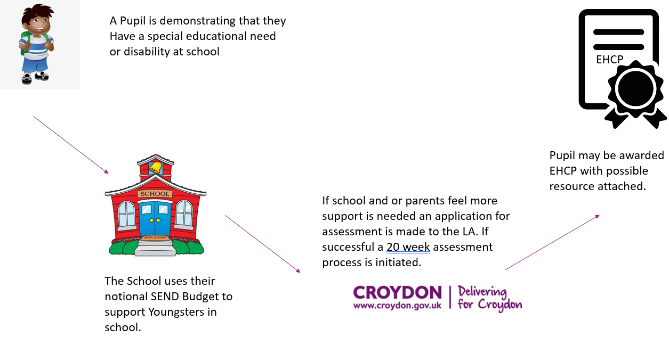
What happened before CLSS?

Slide 12
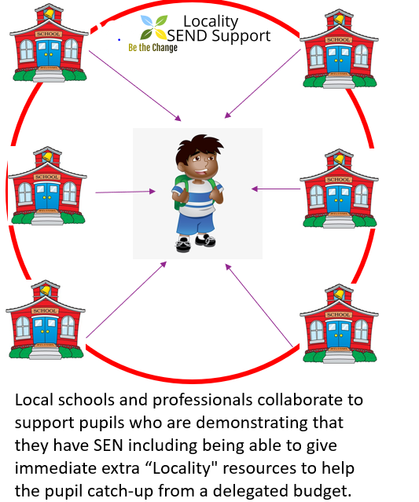
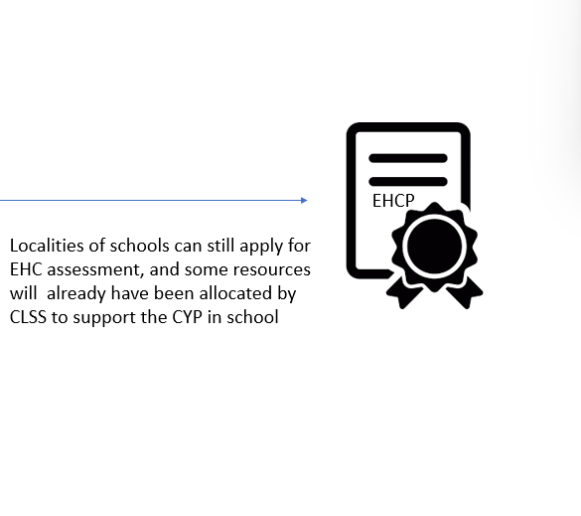
How does the new system work?

Slide 13

Who is supporting your child?
Area SEND Leads:
Sonal Desai
Keran Currie
Mel Farris
School Sendco’s
Educational Psychologists
Class teachers
Headteachers
Speech and language Therapists
Parent(s) and Carer(s)
Medical professionals
CLSS aims to bring professionals together to provide early support and intervention

Slide 14

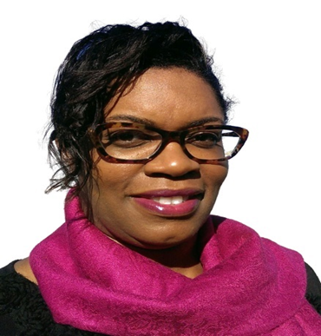
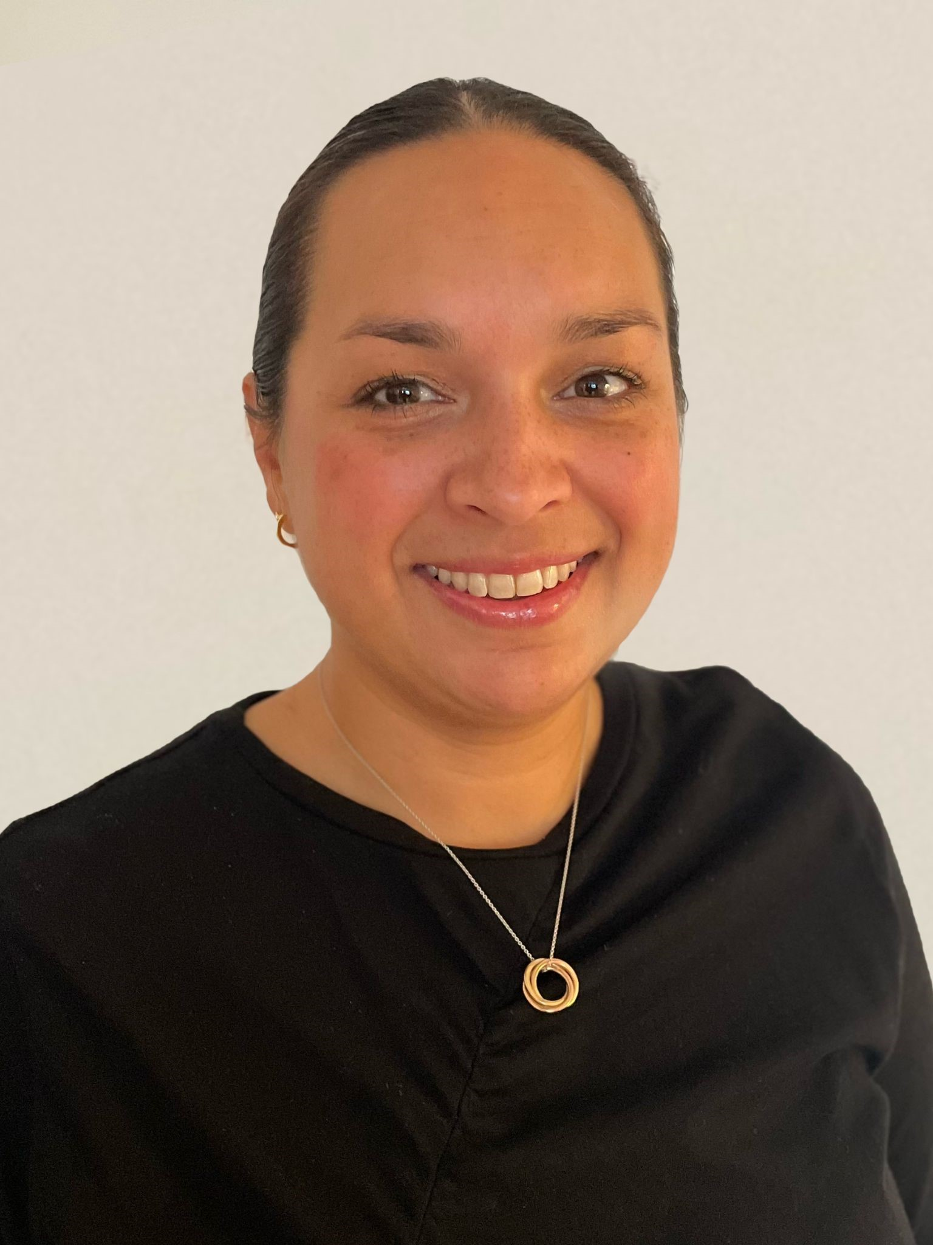
Area SEND Colleagues
Keran Currie
Sonal Desai
Mel Farris

Slide 15
Number of pupils supported since 2020
Locality | CYP supported informally (increase this term) | CYP Supported with resources | Phase
Coulsdon (14 schools) | 525 (+128) | 174 (+35) | 1 (2020)
New Addington (7 schools) | 434 (+30) | 132 (+14) | 1
Selsdon (10 schools) | 601 (+95) | 252 (+53) | 1
Thornton Heath (15 schools) | 649 (+149) | 251 (+59) | 1
Central Croydon (16 schools) | 435 (+110) | 259 (+39) | 2 (2021)
Shirley (17 schools) | 515 (+100) | 221 (+28) | 2
Norwood (16 schools) | 223 (+113) | 88 (+50) | 3 (2022)
Purley (15 Schools) | 211 (+124) | 111 (+59) | 3
MNS (5 Schools) | 92 (+92) | 29 (+29) | 4 (2023)
Totals | 3685 (+941) | 1517 (+366)

Slide 16
Steps in the Locality Process
Step 1
SENDCo speaks to the Area SEND colleague about a child that may need additional support
Step 2
SENDCo and ASL discuss the case and make a decision to either give informal support or refer to a Locality Forum
Step 3
SENDCo presents the child’s case at a monthly Forum with parental permission. Other locality SENDCos and professionals are present.
Step 4
Forum decides on the best support and funds, as appropriate
Step 5
Parents receive outcome feedback from the Forum outlining support that will be offered to the child
If the forum agrees that the child’s needs are complex and long term, they will support an EHC needs assessment.

Slide 17
Support in the Nursery - Early Years
From 1st September 2023, CLSS has responsibility for assessing and funding all NEW applications for special educational needs inclusion funding (SENIF) for children in Maintained nursery classes children and Maintained nursery schools
This funding can be provided to a child as soon as SEND is identified in a Nursery setting
Nursery children are presented at the monthly SENCO forums alongside the mainstream school pupils YR-Y11
There is a new locality for Maintained nursery schools

Slide 18
The work of the Area SEND Leads – day to day
Provide support to SENCOs in 1:1 telephone and virtual meetings
Provide advice and guidance of SEND provision and quality first teaching strategies
Manage and support schools with complex case issues – existing EHCPs, SEN admissions etc.
Liaise with Headteachers, parent/carers and SENCOs when necessary
Monitor mobility of SEN students to support transitions
Visit schools regularly to observe and advise
Liaise with professionals commissioned through CLSS such as SALT and EP practitioners

Slide 19
The work of the Area SEND Leads - Monthly
Plan, facilitate and host Monthly Locality SENCO Forum meetings to hear cases and to share practice
Consider requests made by individual schools and allocating funding where agreed
Prepare and provide, Headteacher, SENCOs and parents with outcome agreement letters and action plans for SEND support.
Overseeing finance requisitions, purchase orders and receipting processes to ensure schools can present invoices for timely payment of Locality Awards
Monthly locality communication and updates
Focusing on monthly SEND themes which are relevant to locality school needs
Moderating SEN cases within the area and against other localities
Managing allocated funding and evaluating the impact of expenditure
Identifying possible improvement projects for groups of schools

Slide 20
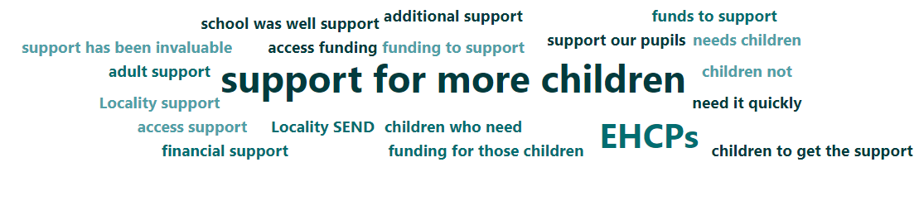
Feedback from schools

Slide 21
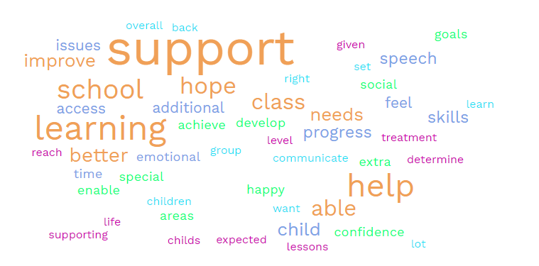
Feedback from parents and carers

Slide 22

Any Questions

