Slide 1
Courgette and cheese croquetas
with tomato bread

Slide 2
Inspiration
Croquetas is a very popular dish in Spain, where my mummy is from. People love them so much that they even celebrate World Croquetas Day on 16th of January!
I have been eating them since I was a little girl. I love them because you can make any flavour —courgette, chicken, ham, mushroom, spinach— just add your choice of ingredient to the bechamel sauce! I usually eat the meat version but thanks to this competition I discovered that courgettes are very yummy (and have lots of vitamin C!).
Pa amb tomaquet or Catalan tomato bread is my favourite! It is so much fun to make —squeezing the tomatoes and rubbing them into the bread.
This dish reminds me of my grandma and hot summers by the beach with my family and friends.

Slide 3
Ingredients
For the croquetas filling
1 courgette (250 gr. approx.)
1 medium onion
Grated cheese (80 gr.)
Bechamel sauce (thick consistency)
1 ½ tbs butter
1 ½ tbs flour
1 cup warm milk
Nutmeg and salt
For the breading
Flour, egg and breadcrumbs.
For the tomato bread
Bread, ripe tomatoes, olive oil and salt.

Slide 4
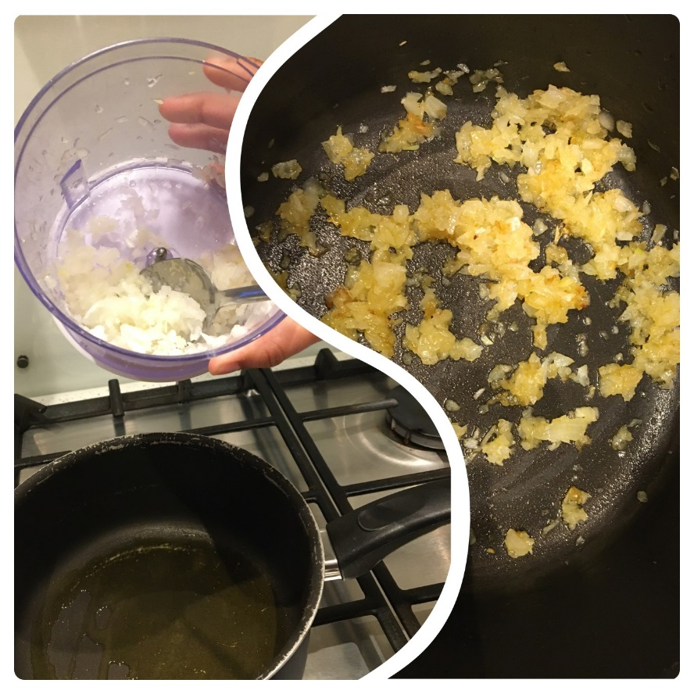
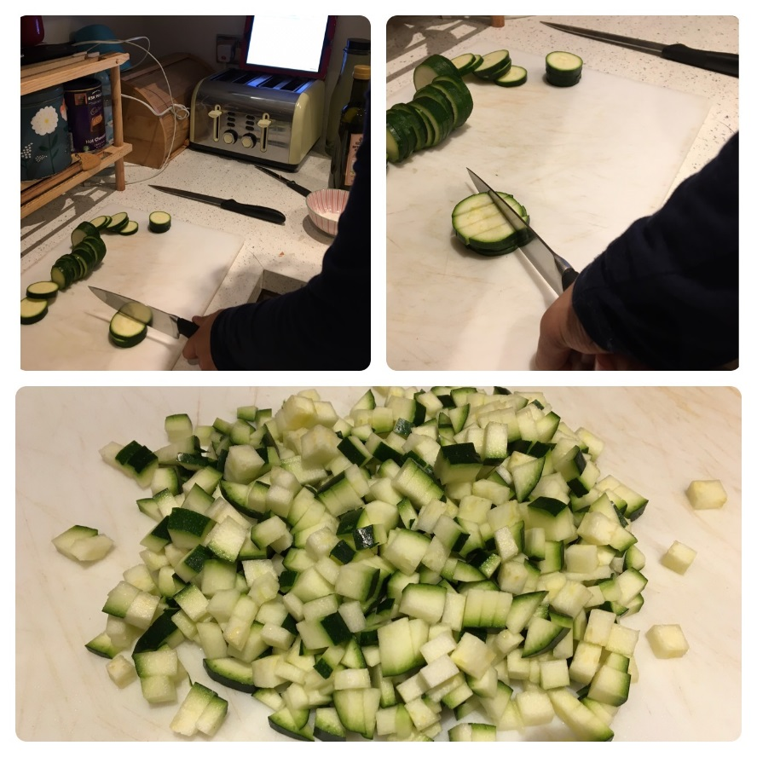
Instructions
Mince the onion and fry it until golden brown.
Slice the courgettes and cut them into small dices. Pour in the pan with the onions and fry until soft.

Slide 5
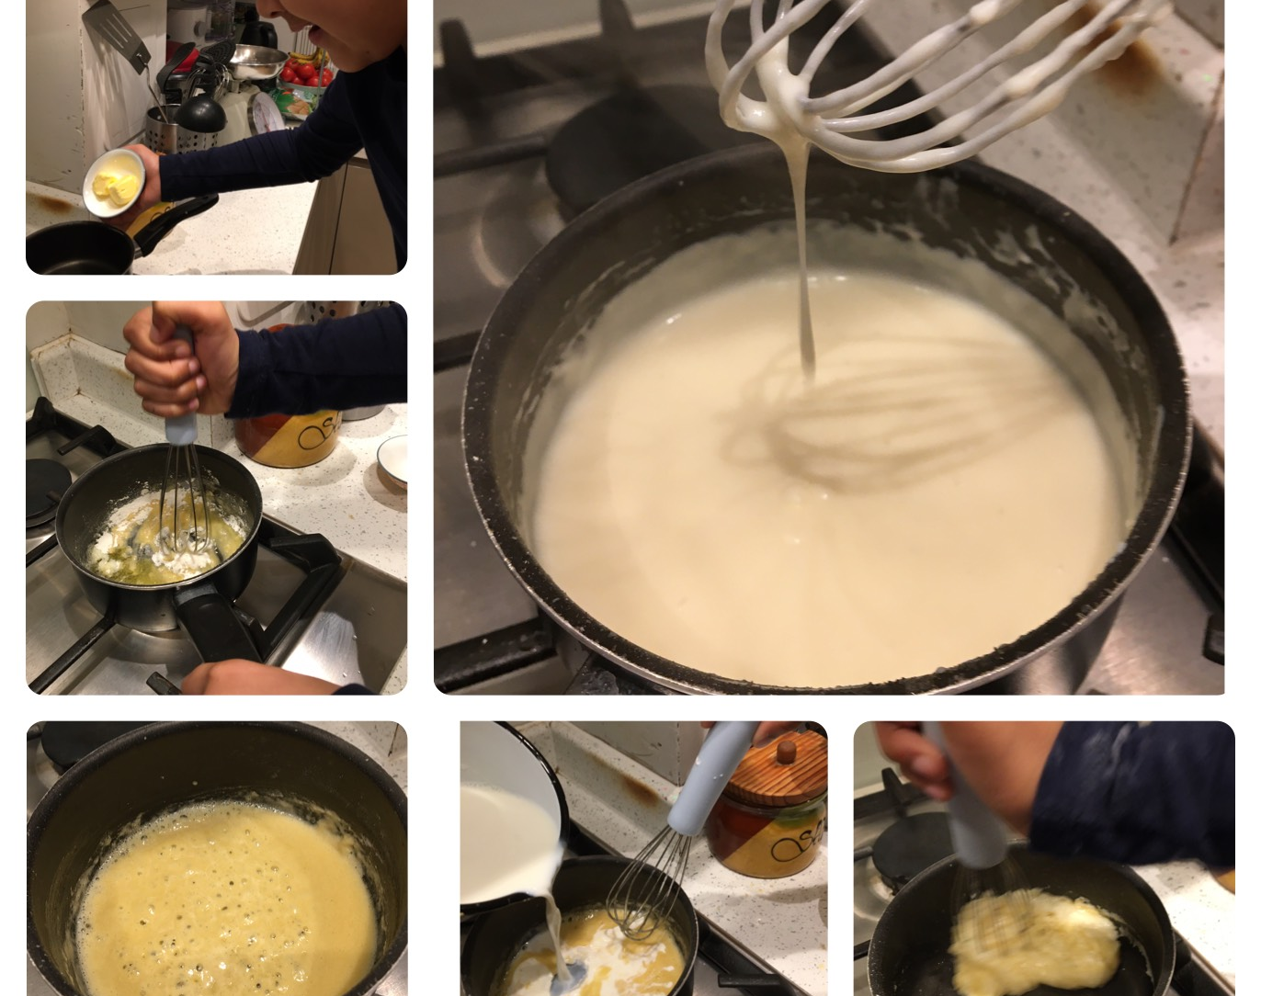
Prepare the bechamel:
Melt the butter in a small pan.
Pour the flour and whisk together.
When they are mixed well, pour some of the warm milk and whisk well until mixed.
Keep adding milk and mixing until you get the right thickness.
Add nutmeg and salt to taste.

Slide 6
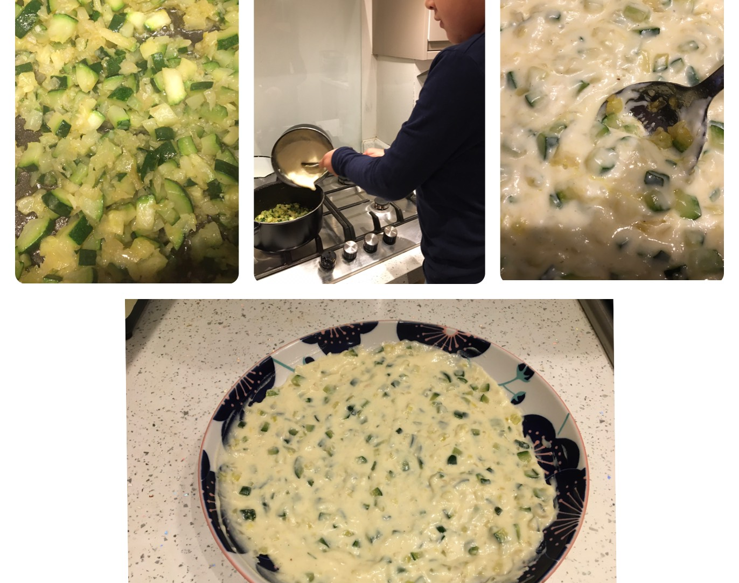
Prepare the filling
1. When the courgettes are soft pour in the bechamel sauce, mix well and place in a dish.
2. Cool in the fridge overnight. If you need to cook them immediately you can put them in the freezer for a couple of hours.

Slide 7
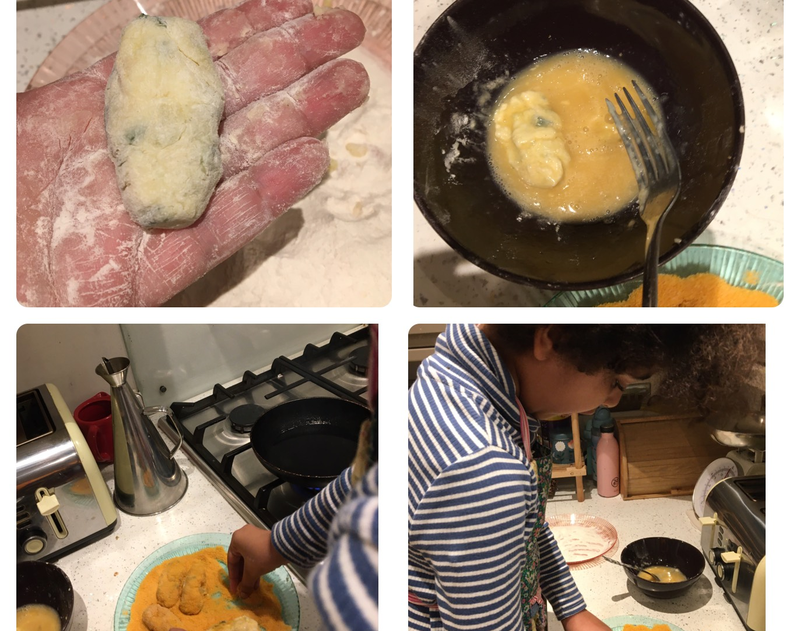
Shape and bread the croquetas:
Dust your hands with flour and with the help of a teaspoon, get a small portion of the filling. Shape the croqueta with your hands.
Whisk an egg and roll the croqueta in.
Sprinkle with breadcrumbs.

Slide 8
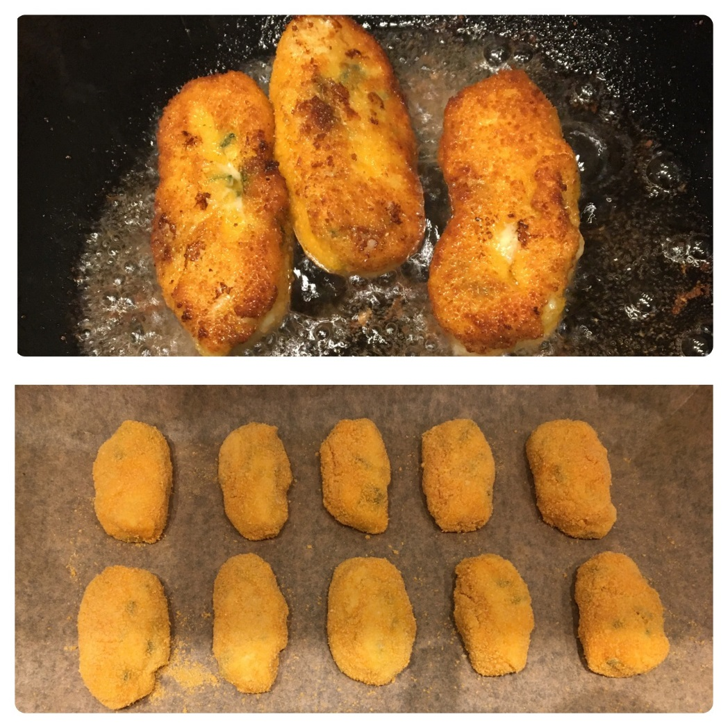
Now you can either fry them in olive oil (make sure oil is hot) or bake them in the oven at 180° for 20 min or until golden.

Slide 9
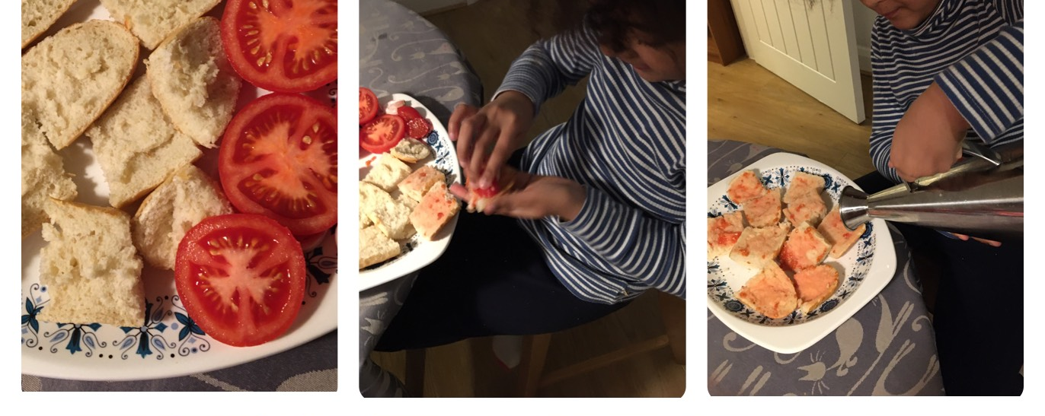
For the tomato bread:
Cut a loaf of bread into chunks and then into halves.
Cut a few ripe tomatoes into halves.
Rub the tomato into the bread while squeezing it.
Sprinkle with some olive oil and salt (and enjoy a cheeky one!).

Slide 10
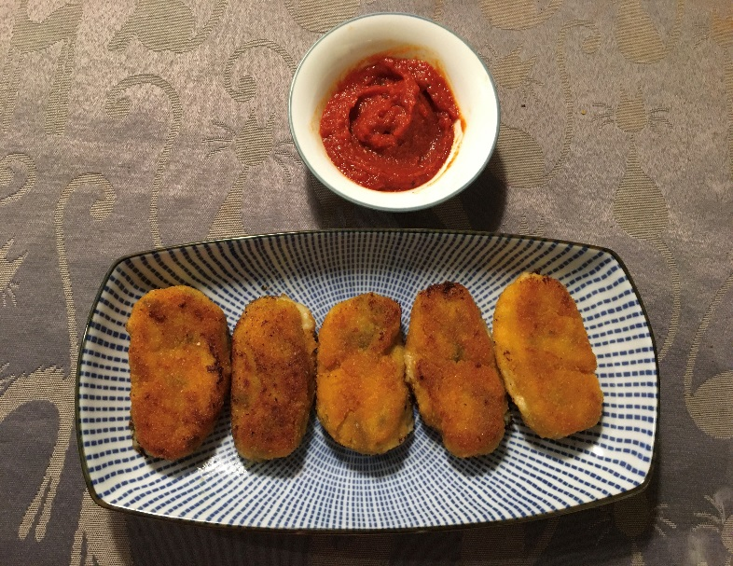
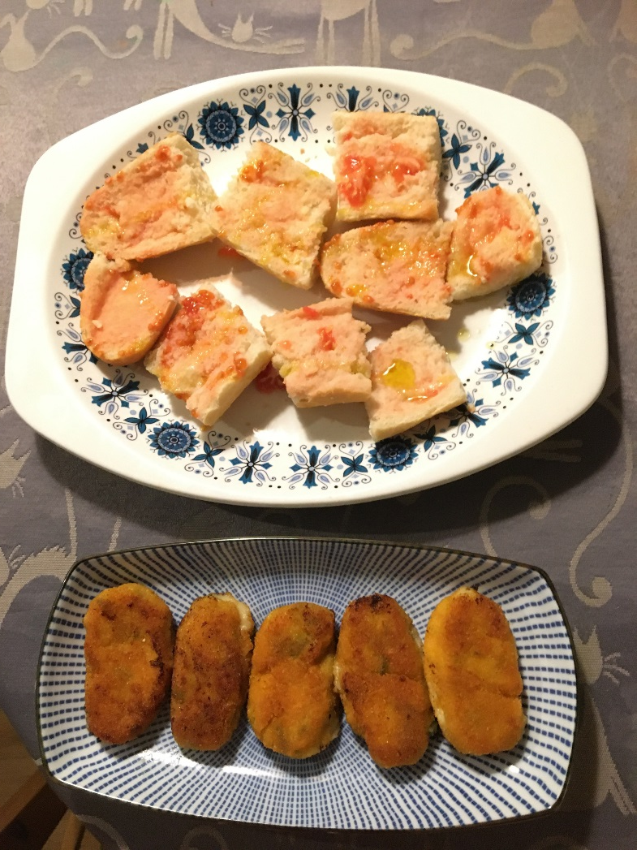
And presto!
You can either eat them with tomato bread or dip them into tomato sauce.
I hope you enjoy it!

