Slide 1
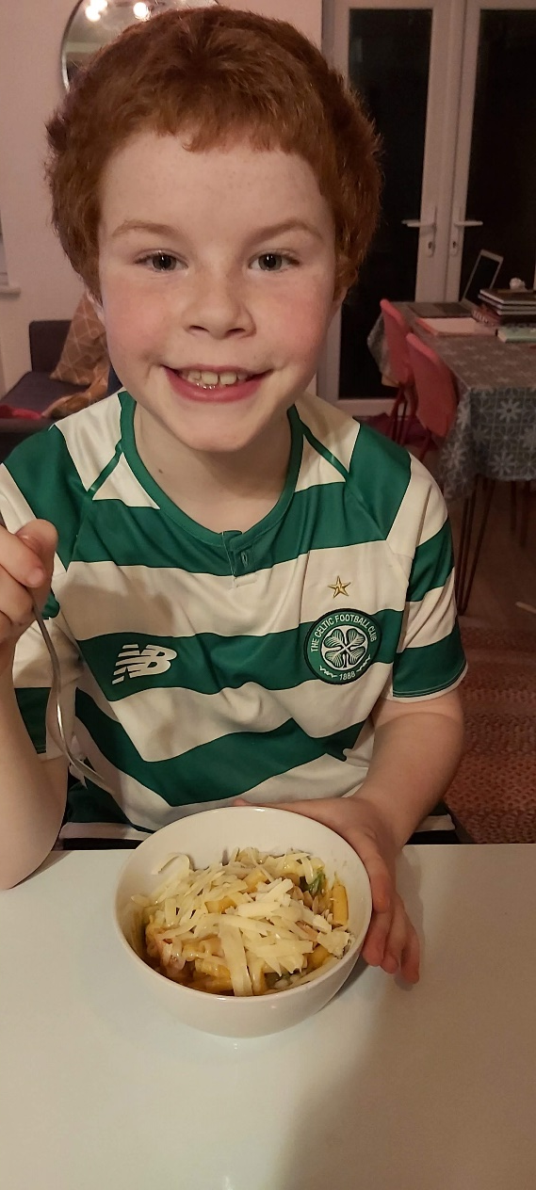
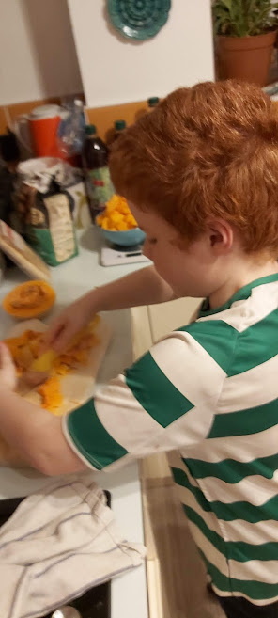
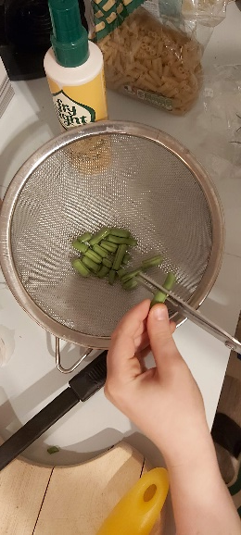
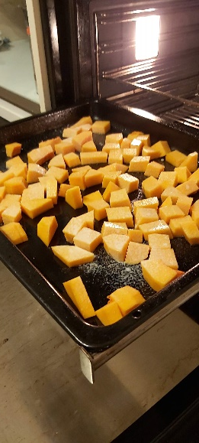
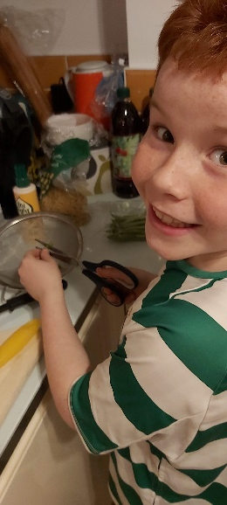
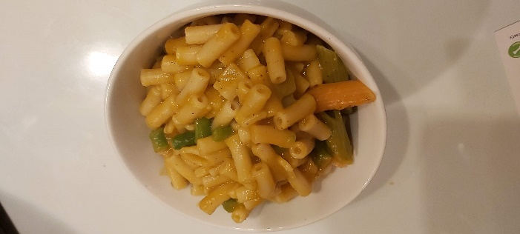
‘No Cheese’ Butternut Squash Mac & Cheese My sister HATES cheese, but Mac and Cheese is my favourite. We found this recipe to keep us both happy!!!
Ingredients
300g any type of pasta. (we used macaroni and left over Christmas shapes!)
1 chopped onion
2 teaspoons of lazy garlic
pinch of chilli pepper (optional)
480ml vegetable stock, we used a stock cube
Approx 700g of butternut squash, we used a whole small one.
A handful of chopped string beans
salt and black pepper
Grated Cheese to sprinkle on top
Method
Heat the oven to 200c
Chop the butternut squash into cubes, and put into a baking tray, sprinkle with salt and pepper, bake for 30min
While it’s cooking, spray a pan with oil and cook the onions until soft, then add the garlic and fry for 1min.
Add the butternut squash once cooked with the stock.
Bring to boil and simmer for 5mins.
Then carefully pour it all into a blender and blend it until smooth.
While that is happening, boil the pasta for 10 to 15mins, after 5 mins, add the string beans to the water.
Drain the pasta and beans and add the blended sauce to it.
Stir until all the pasta is covered.
Serve and sprinkle some cheese on top if you want.

