Slide 1

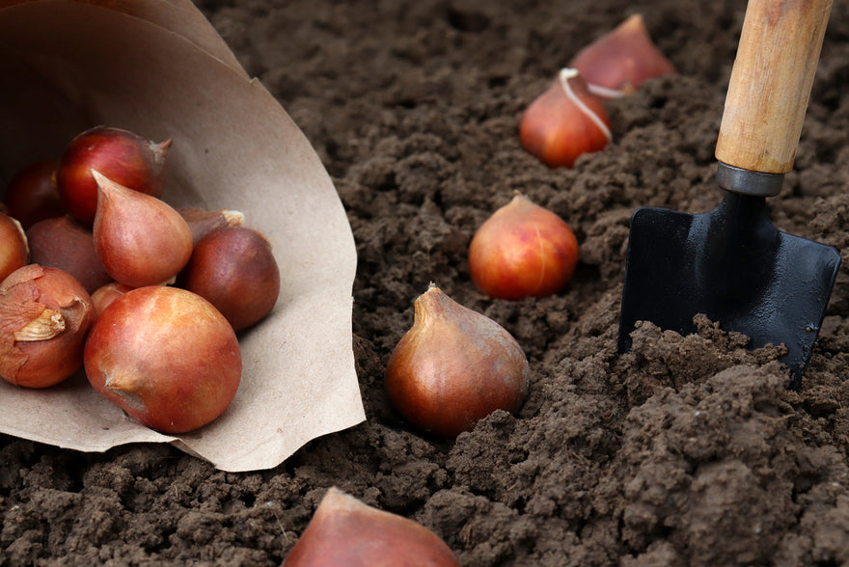
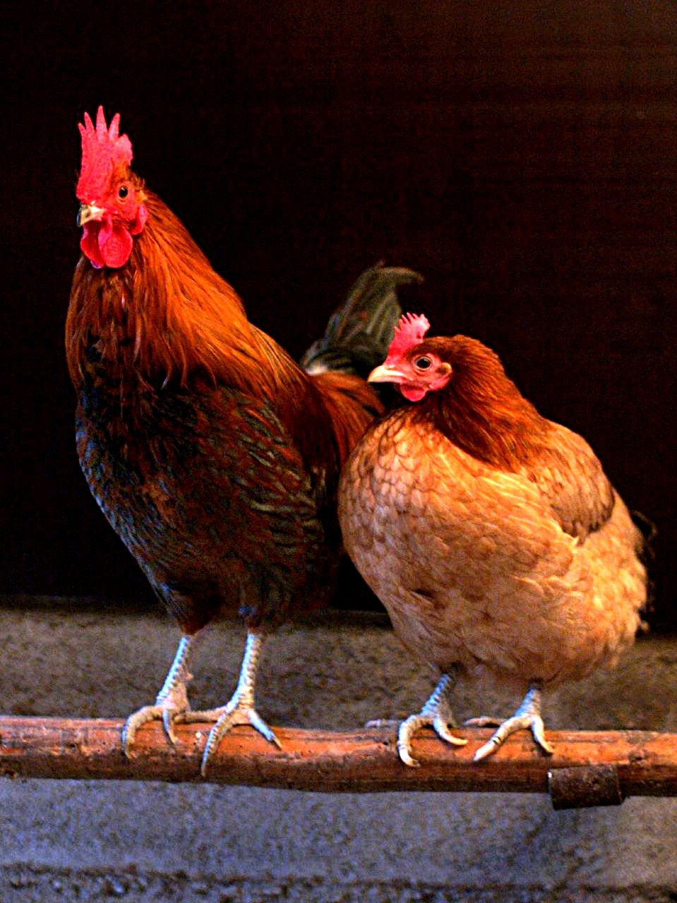
Rockmount Community Club
This Sunday (25/2/24) come and join us for some REAL outdoor fun. From 10am till 12pm we will be -
1) Planting bulbs / seeds
2) Weeding the Edible Garden and Wildlife Garden
3) Cutting back and tying in the kiwi plant
4) Clearing around the hedgerow
5) See the ‘Rockmount Chickens and Rabbits’
6) Make ‘SMORES’ on the campfire
Refreshments will be provided around the campfire.
According to the Met Office the weather should be overcast but with a
slight chance of rain (please bring your waterproofs).
Looking forward to seeing you all on Sunday 10am till 12pm.
Daniel Ricketts

