Slide 1
Introduction to Oracy

Slide 2

What do we mean by the term oracy?
“Articulating ideas, developing understanding and engaging with others through speaking, listening and communication.”
Oracy Commission report
“Oracy is the ability to use the skills of speaking, listening and non-verbal communication for a wide range of purposes.”
Oracy Cambridge’s definition
Notes:
To date, there has been no universally agreed-upon definition of oracy, nor a broad consensus on its role in education.
What is your response to these definitions?
What is the difference between the two? Do you prefer one over the other?

Slide 3

What do we mean by the term oracy?
The term ‘oracy’ was coined in the 1960s by Andrew Wilkinson.
His notion was that oracy – the ability to express oneself fluently in speech – should be given equal status to numeracy and literacy in school curriculums
Do you think this is the case in schools currently? Why? Why not?

Slide 4
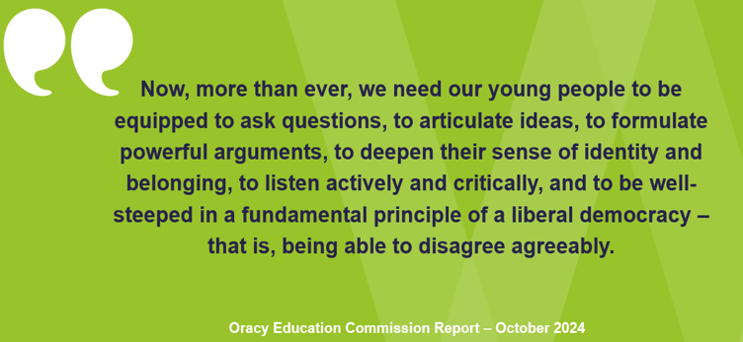
Why does oracy matter?

Slide 5
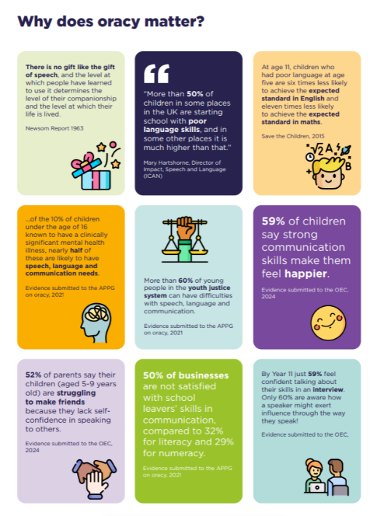

Slide 6
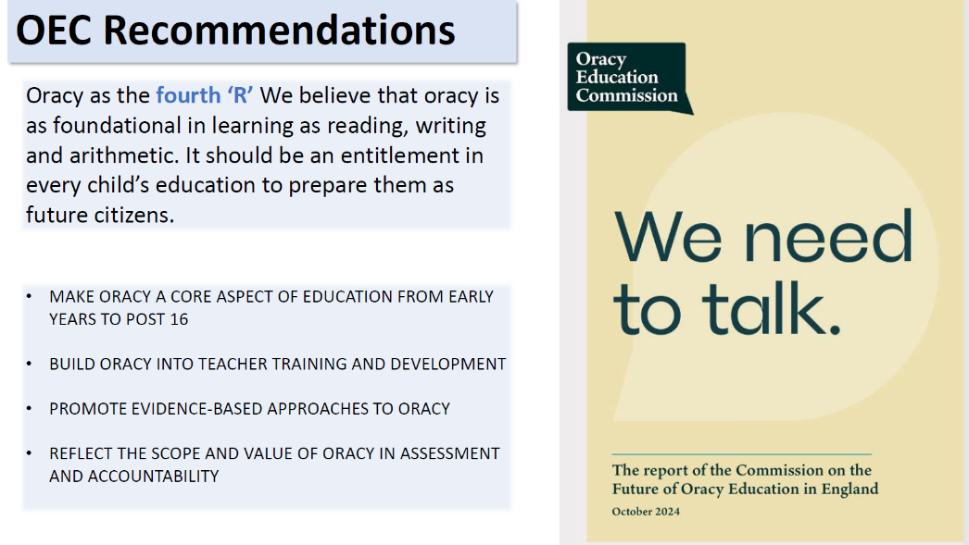
Why does oracy matter?

Slide 7
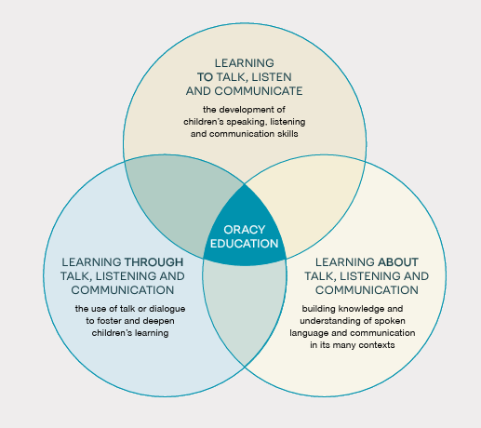
What does oracy education look like?
Notes:
Oracy education is understood to be the intentional cultivation of this ability. It comprises three interrelated, overlapping and mutually reinforcing components:
Learning how to talk – developing children’s ability to improve and apply their oracy skills (speaking, listening and communication skills)
Learning about talk – helping children to understand the nature of language and how it works
Learning through talk - the use of talk or dialogue to foster and deepen children’s learning

Slide 8
Our next steps – developing a positive ethos for oracy
“Teach explicitly during classroom sessions how to be a good speaker and listener, how to talk in a group situation or with a partner, what type of talk is needed for different situations, who to talk with, what role they may have in group interactions, how to extend the conversation without asking too many questions.”
Mercer and Dawes

Slide 9
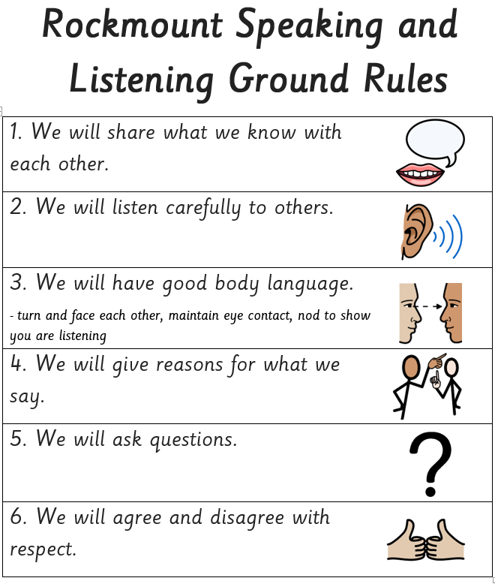
Our next steps
Agree a set of talk conventions with the class

Slide 10
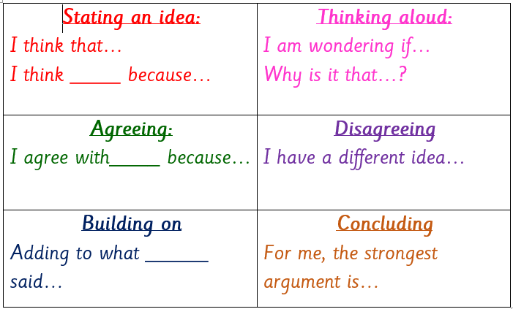
Our next steps
Introduce key ‘talk vocabulary’
Model successful talk
Give children opportunities to engage in talk activities and then ask them to reflect on the quality of talk

Slide 11
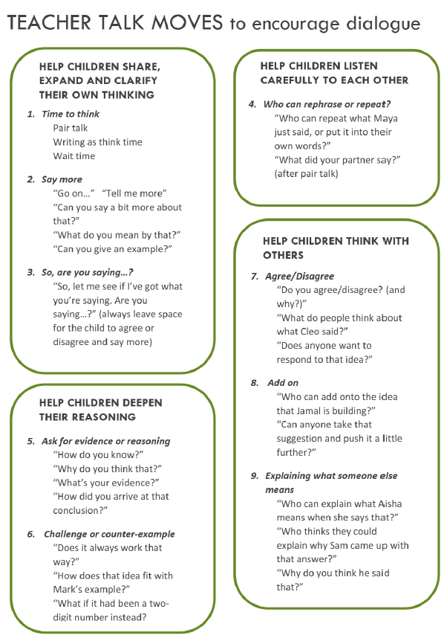
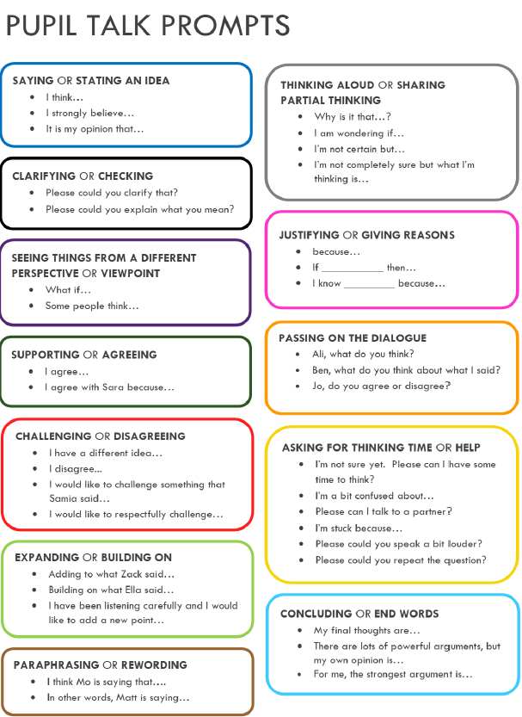

Slide 12
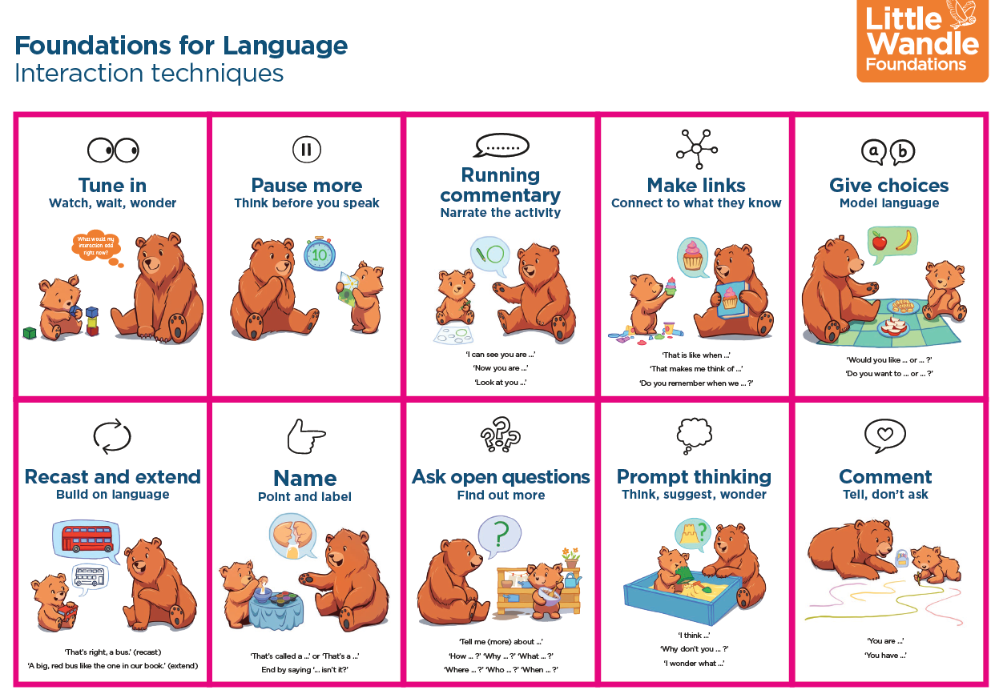

Our next steps
Little Wandle Foundations for Language project in nursery
Oracy Cambridge oracy project with Croydon – talk audit 18th November

